Slide 1
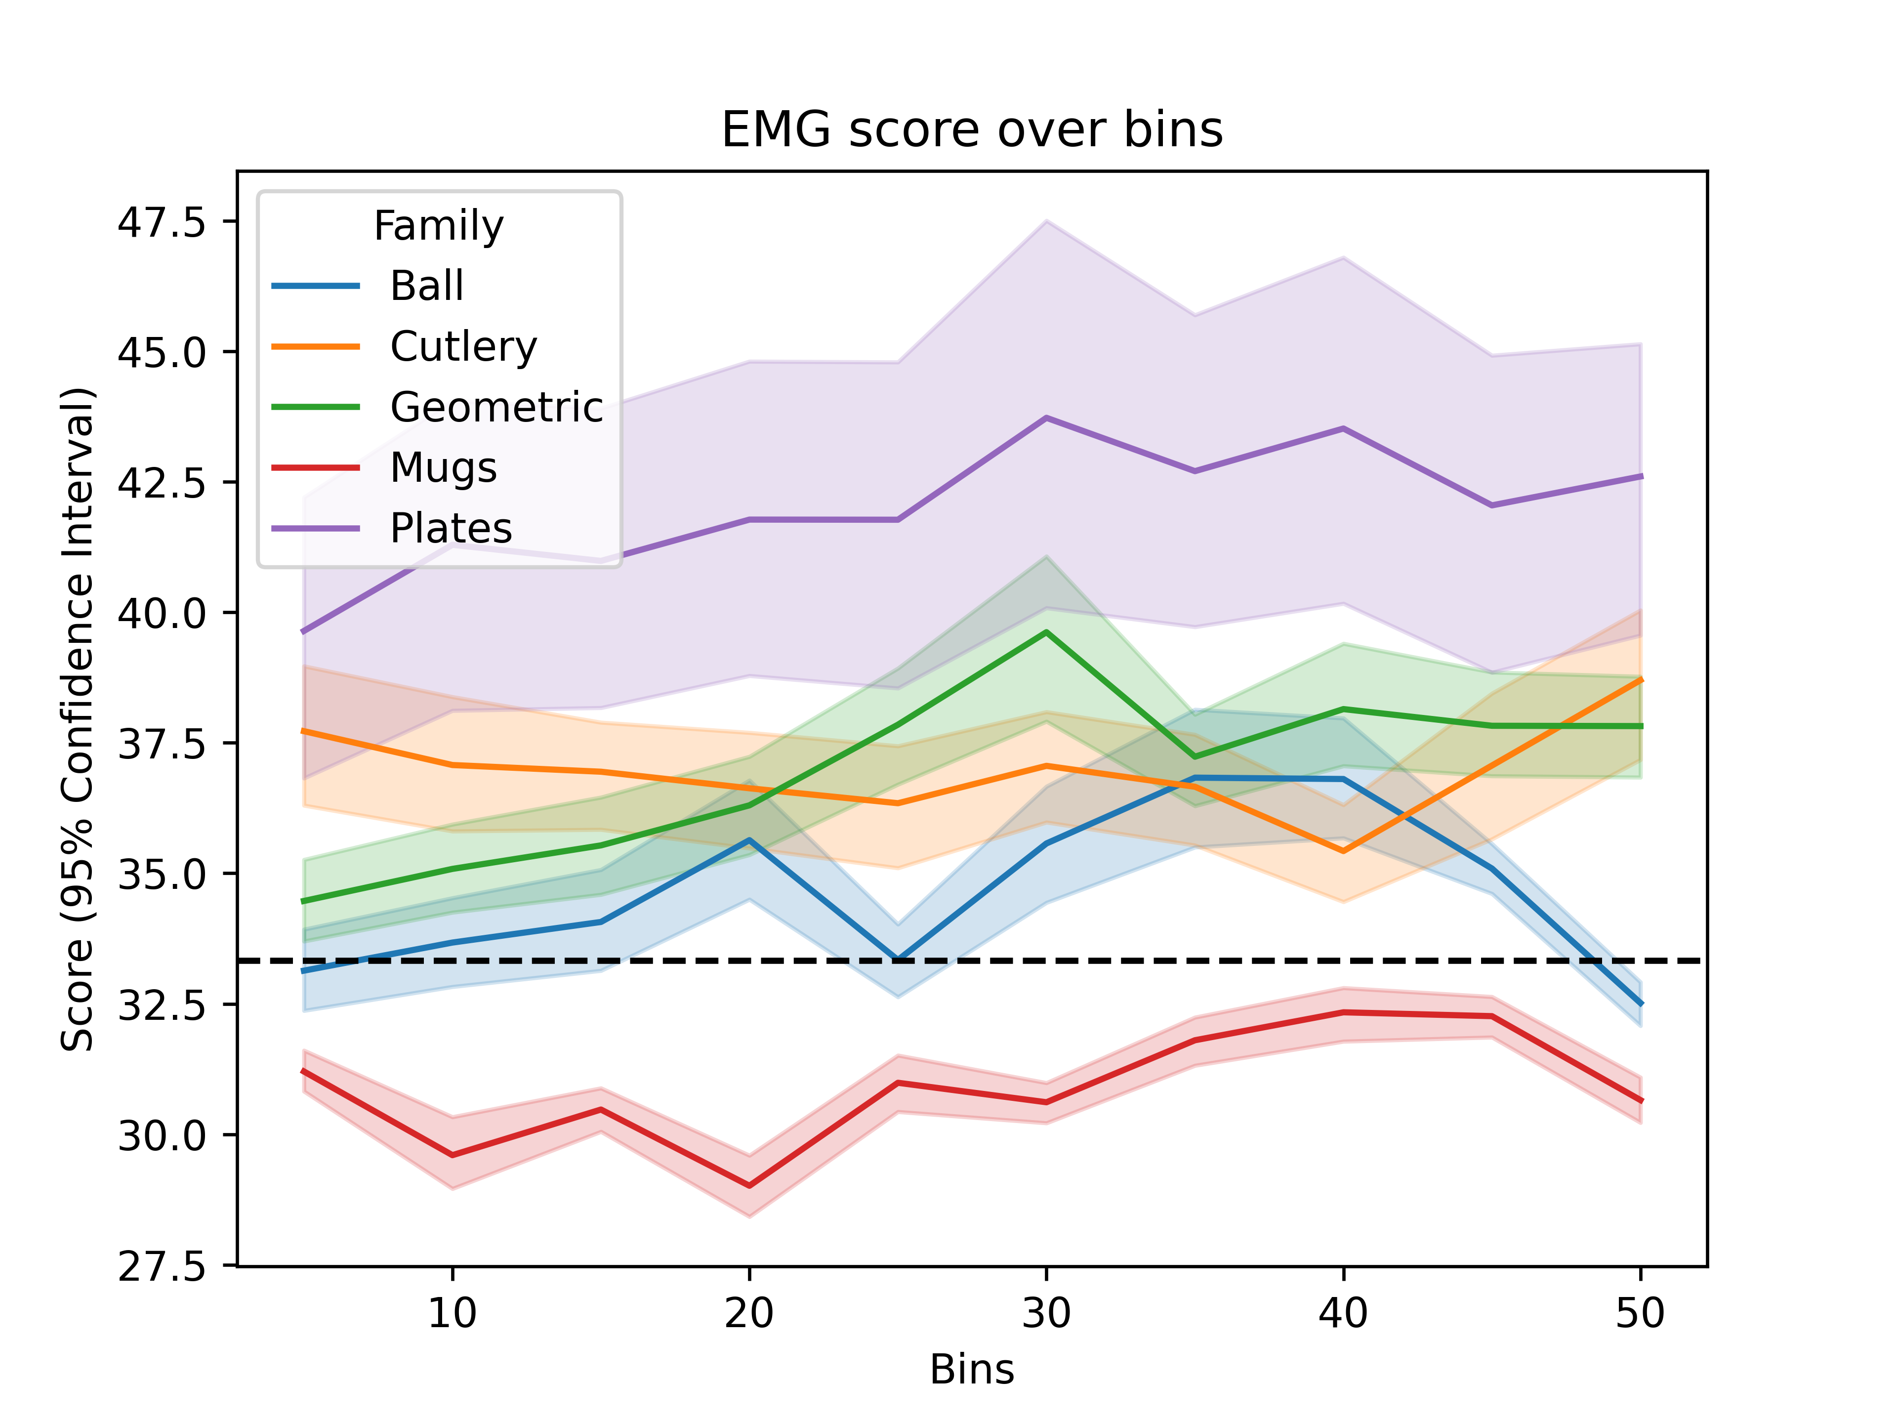

Slide 2
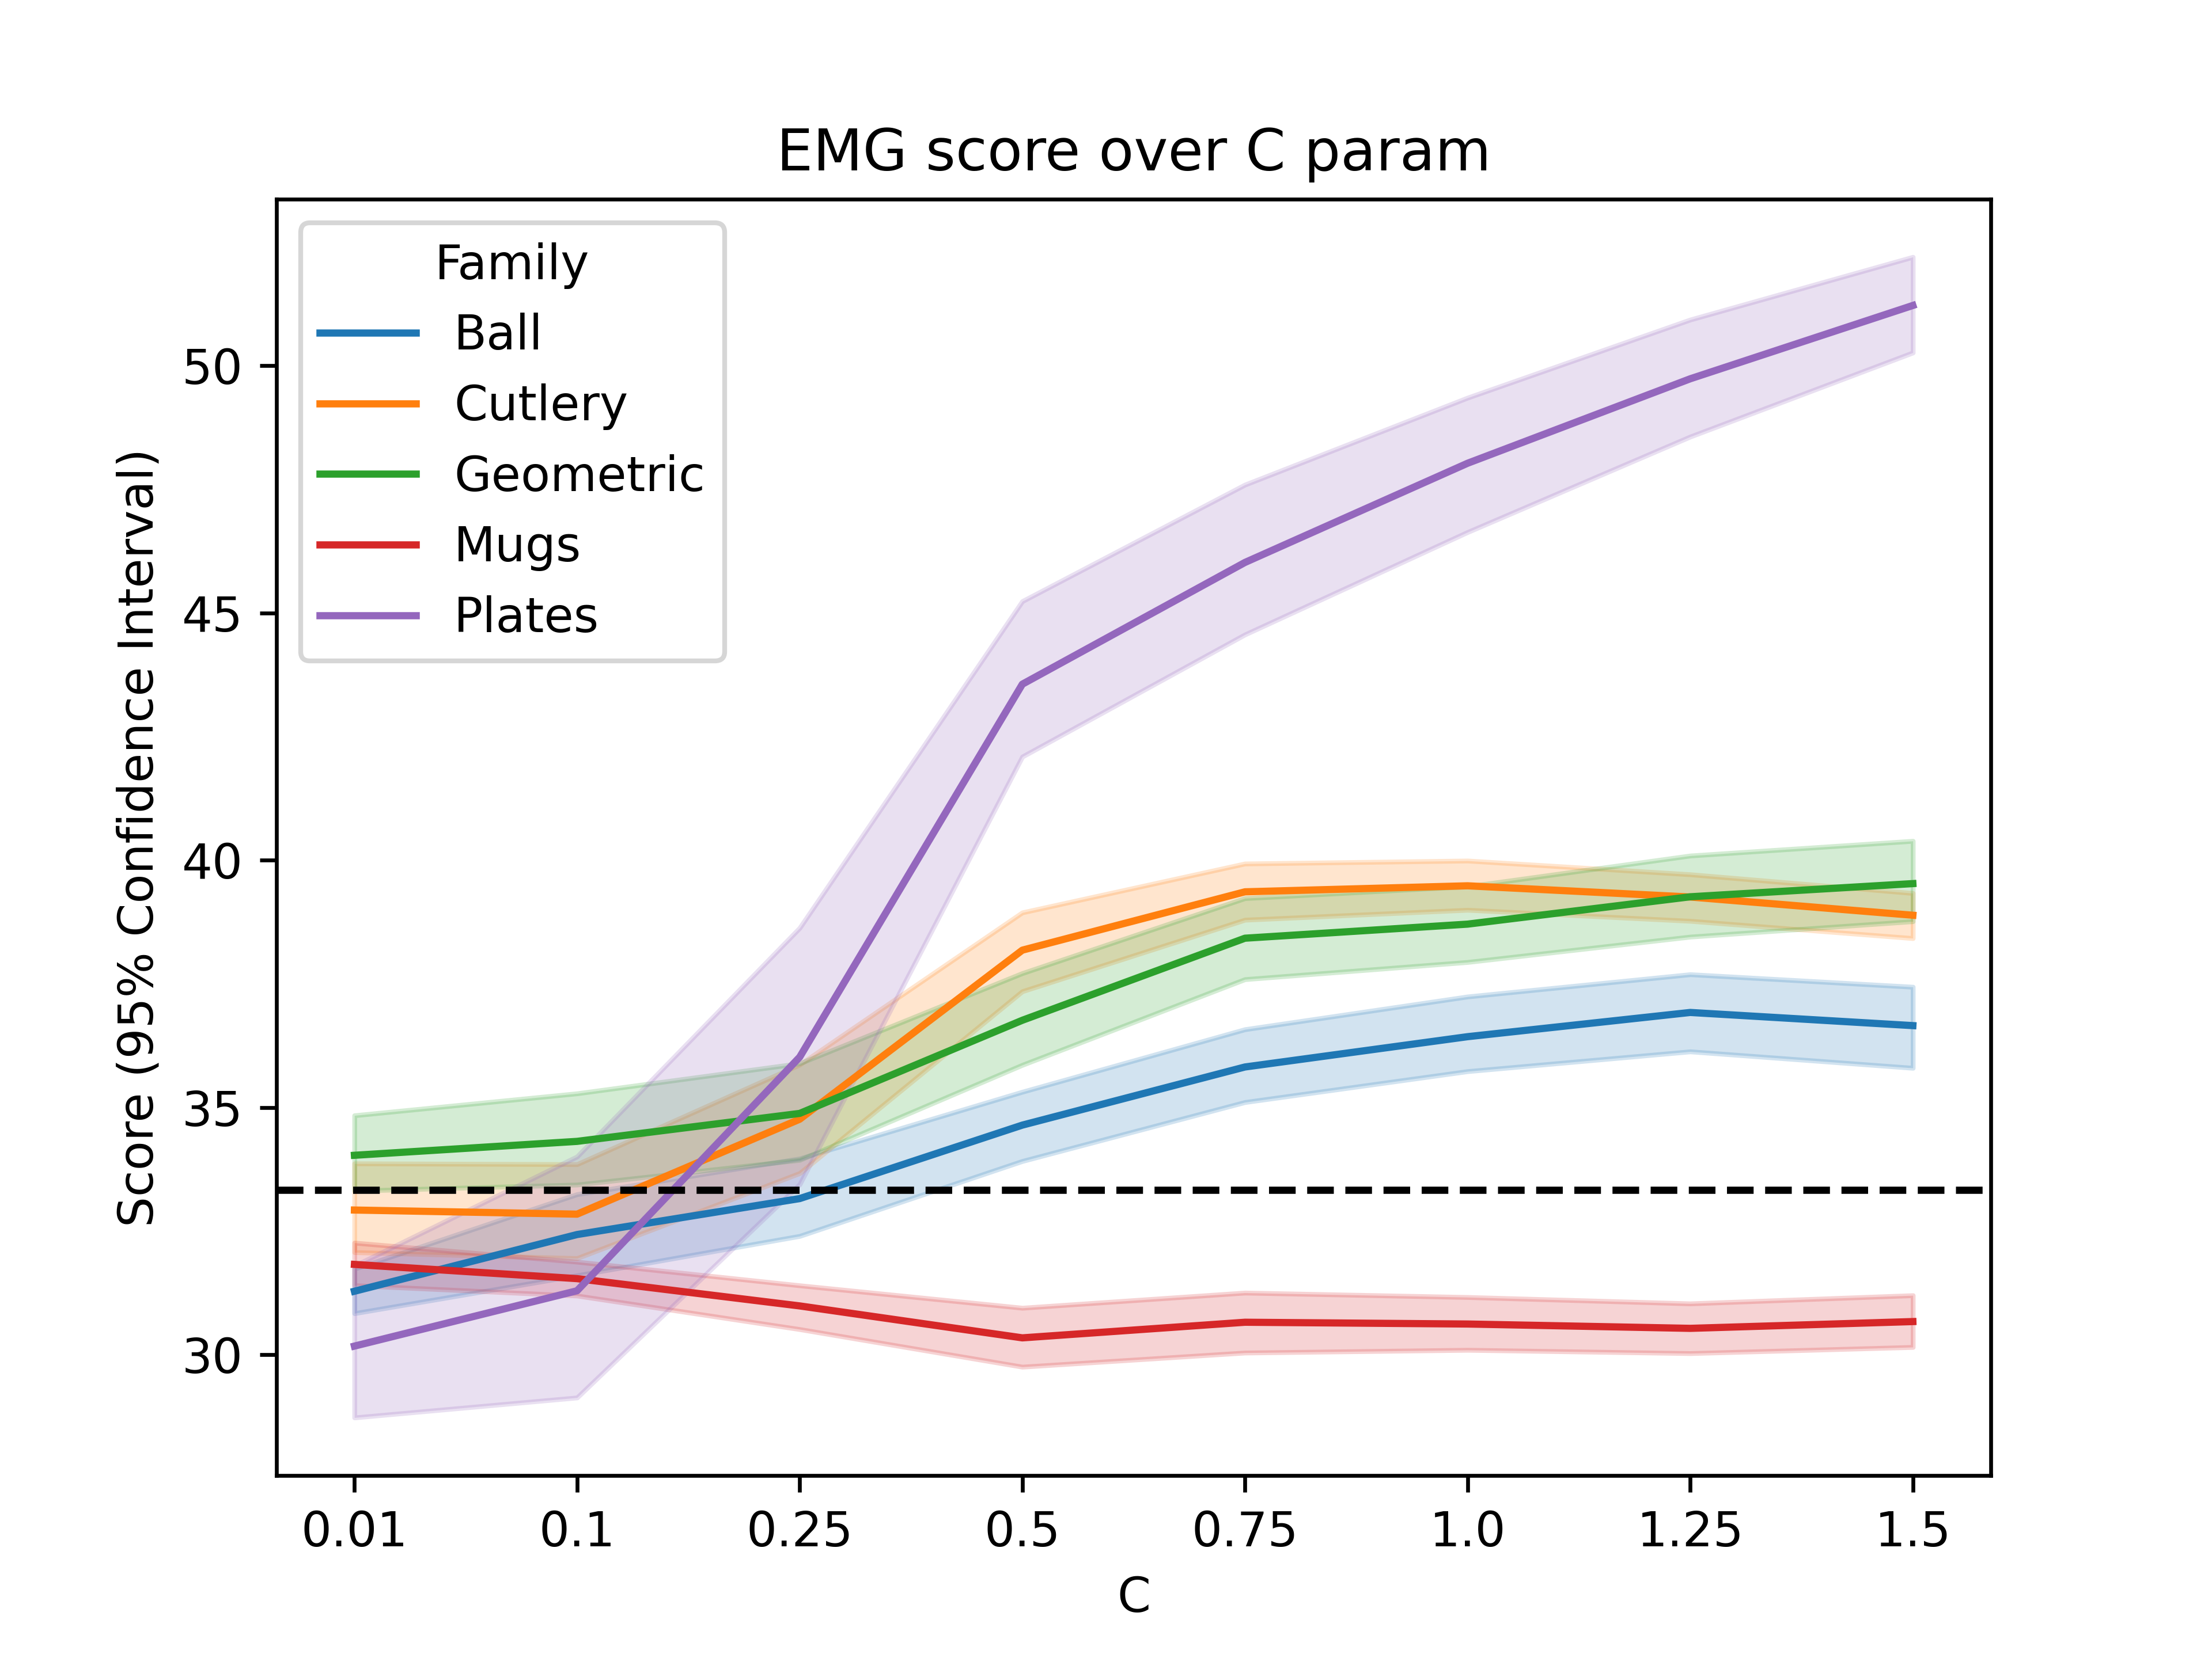

Slide 3
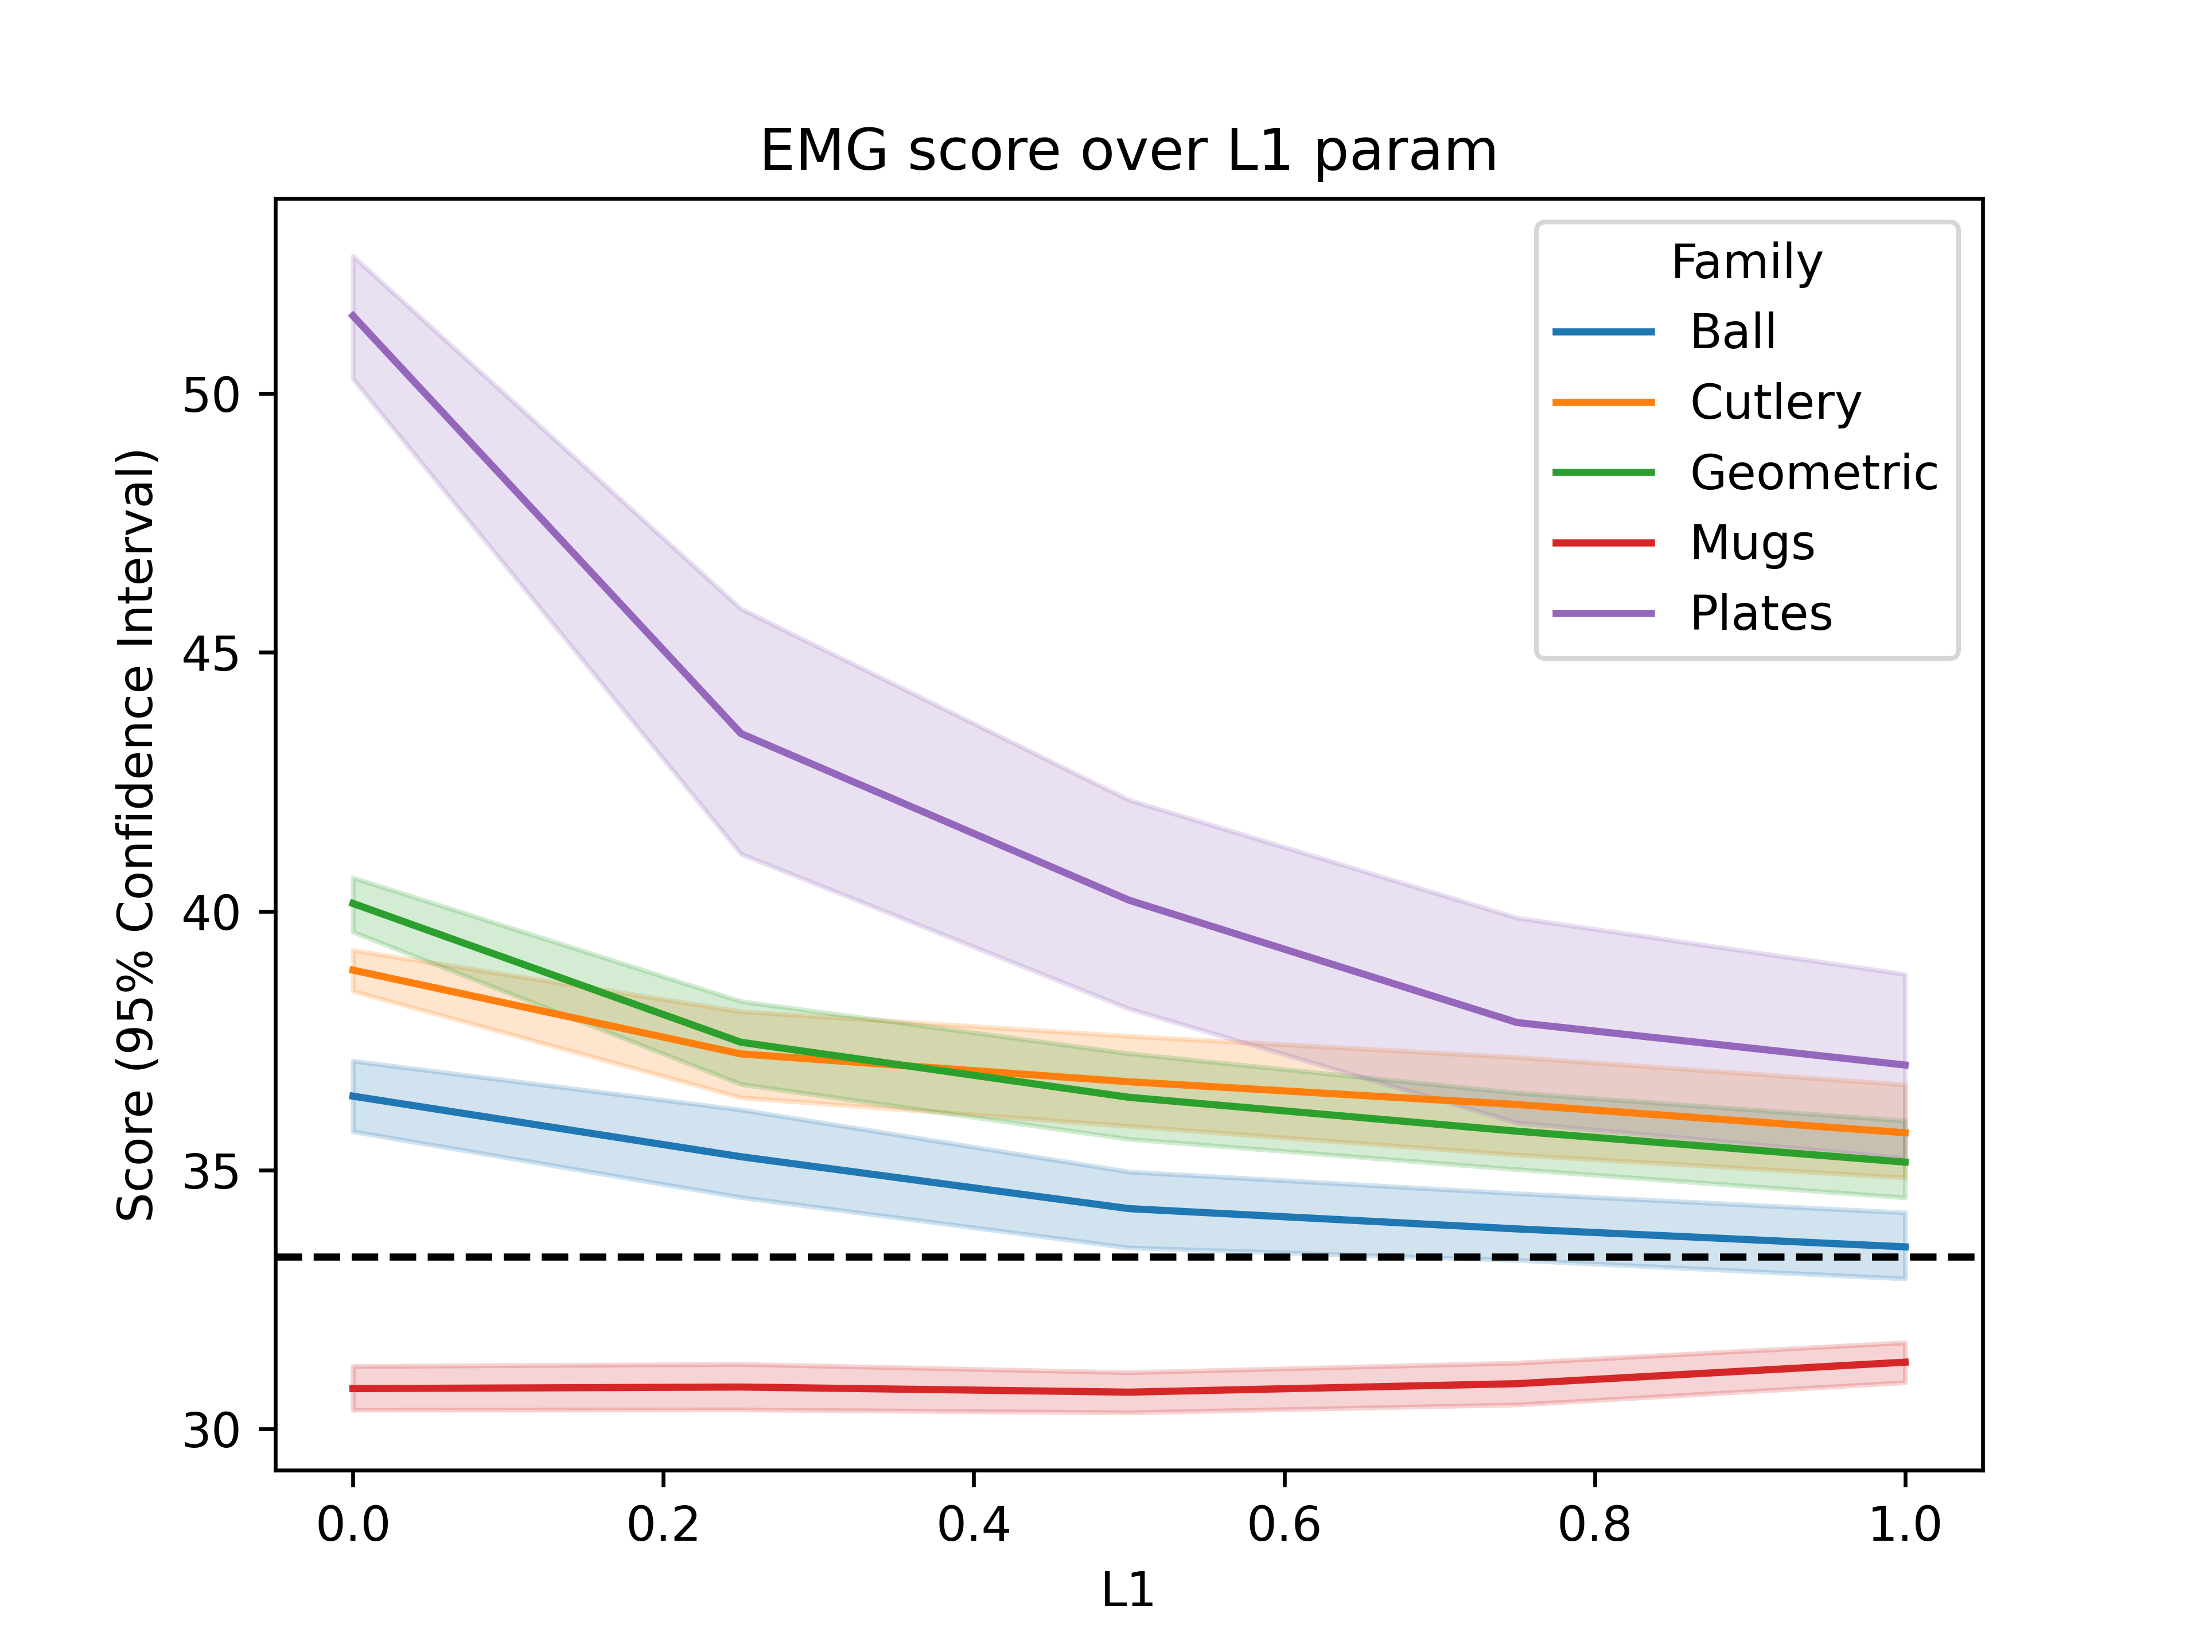

Slide 4
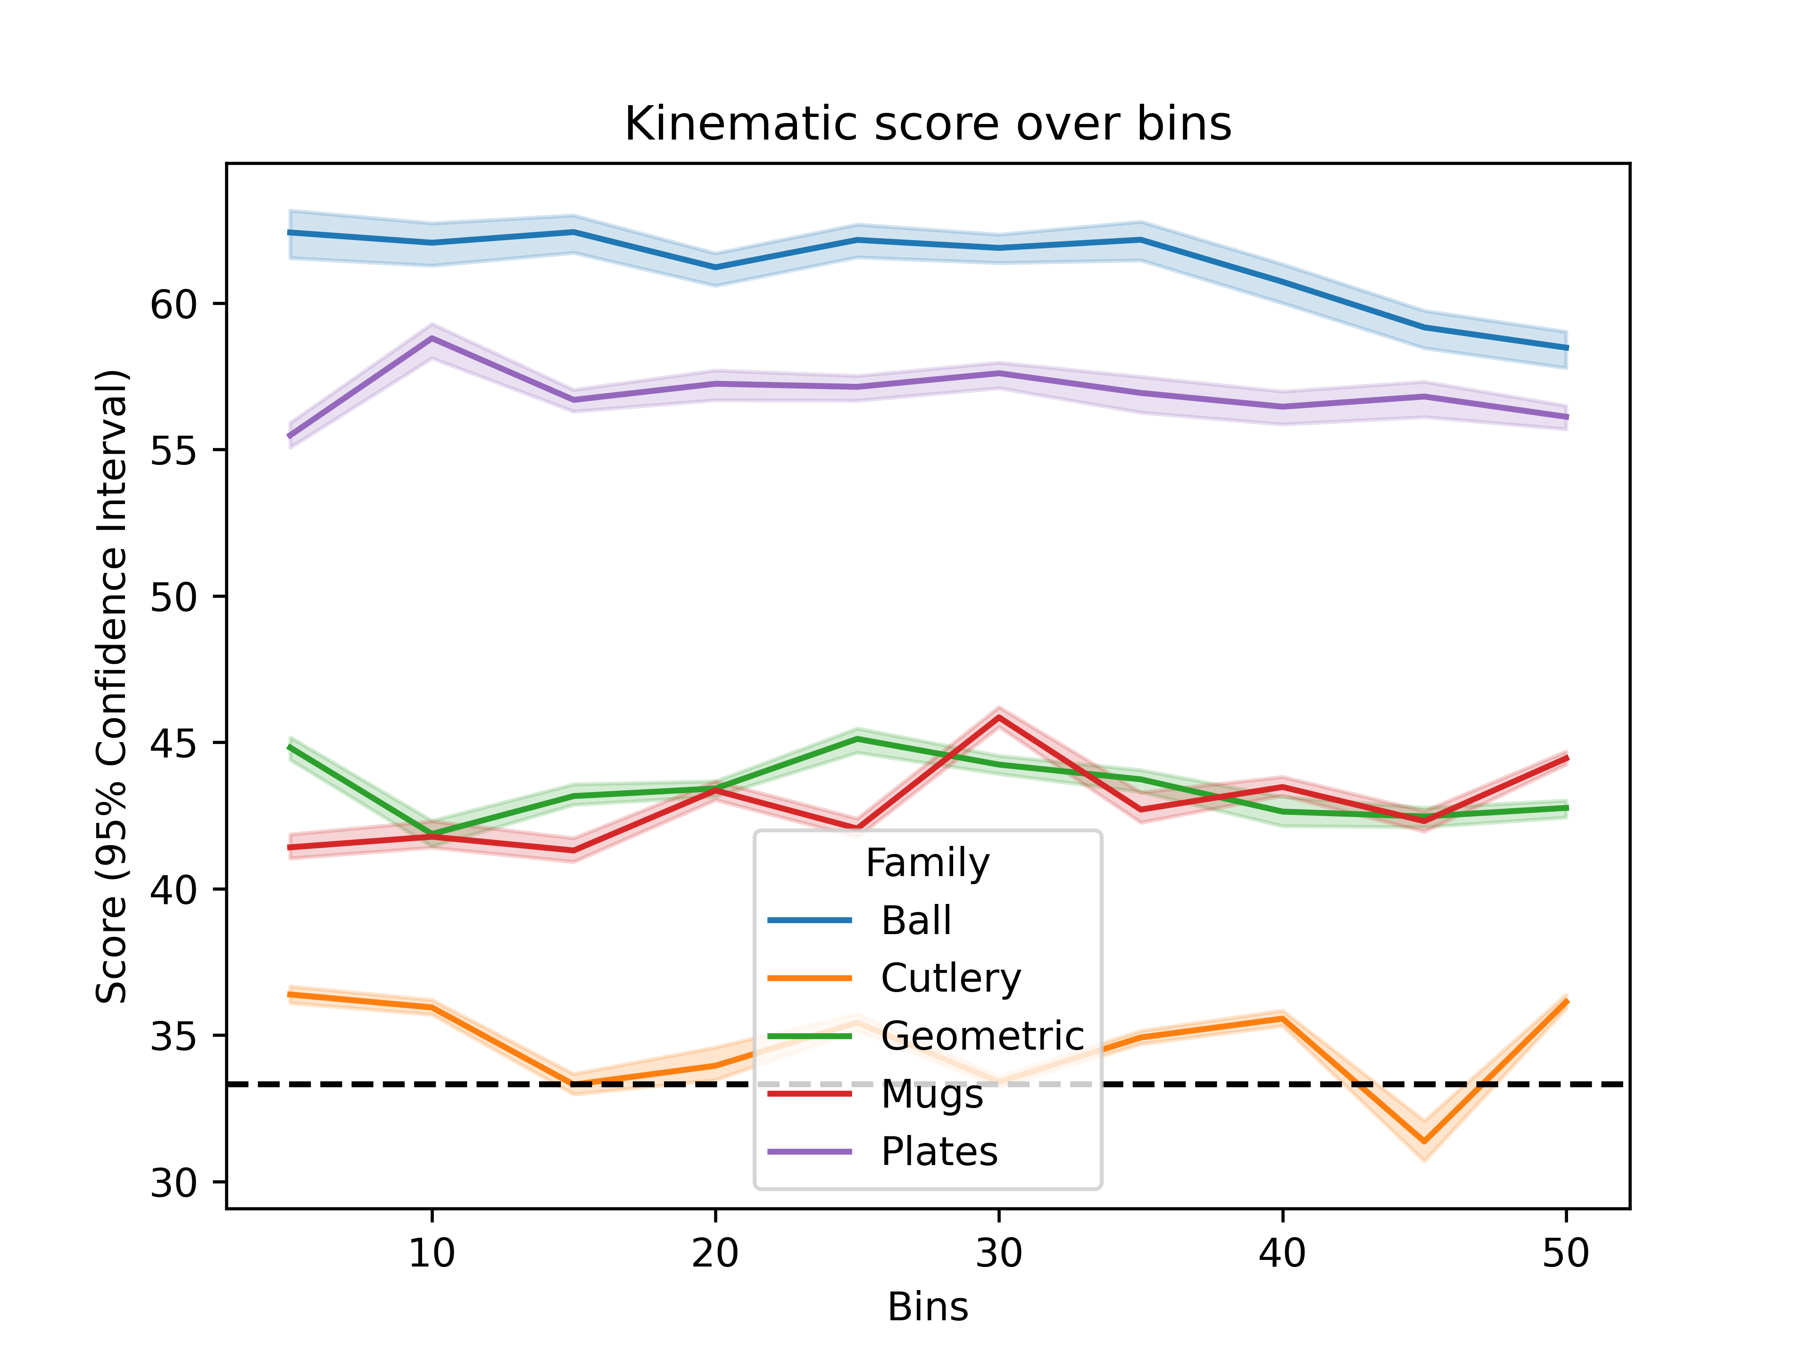
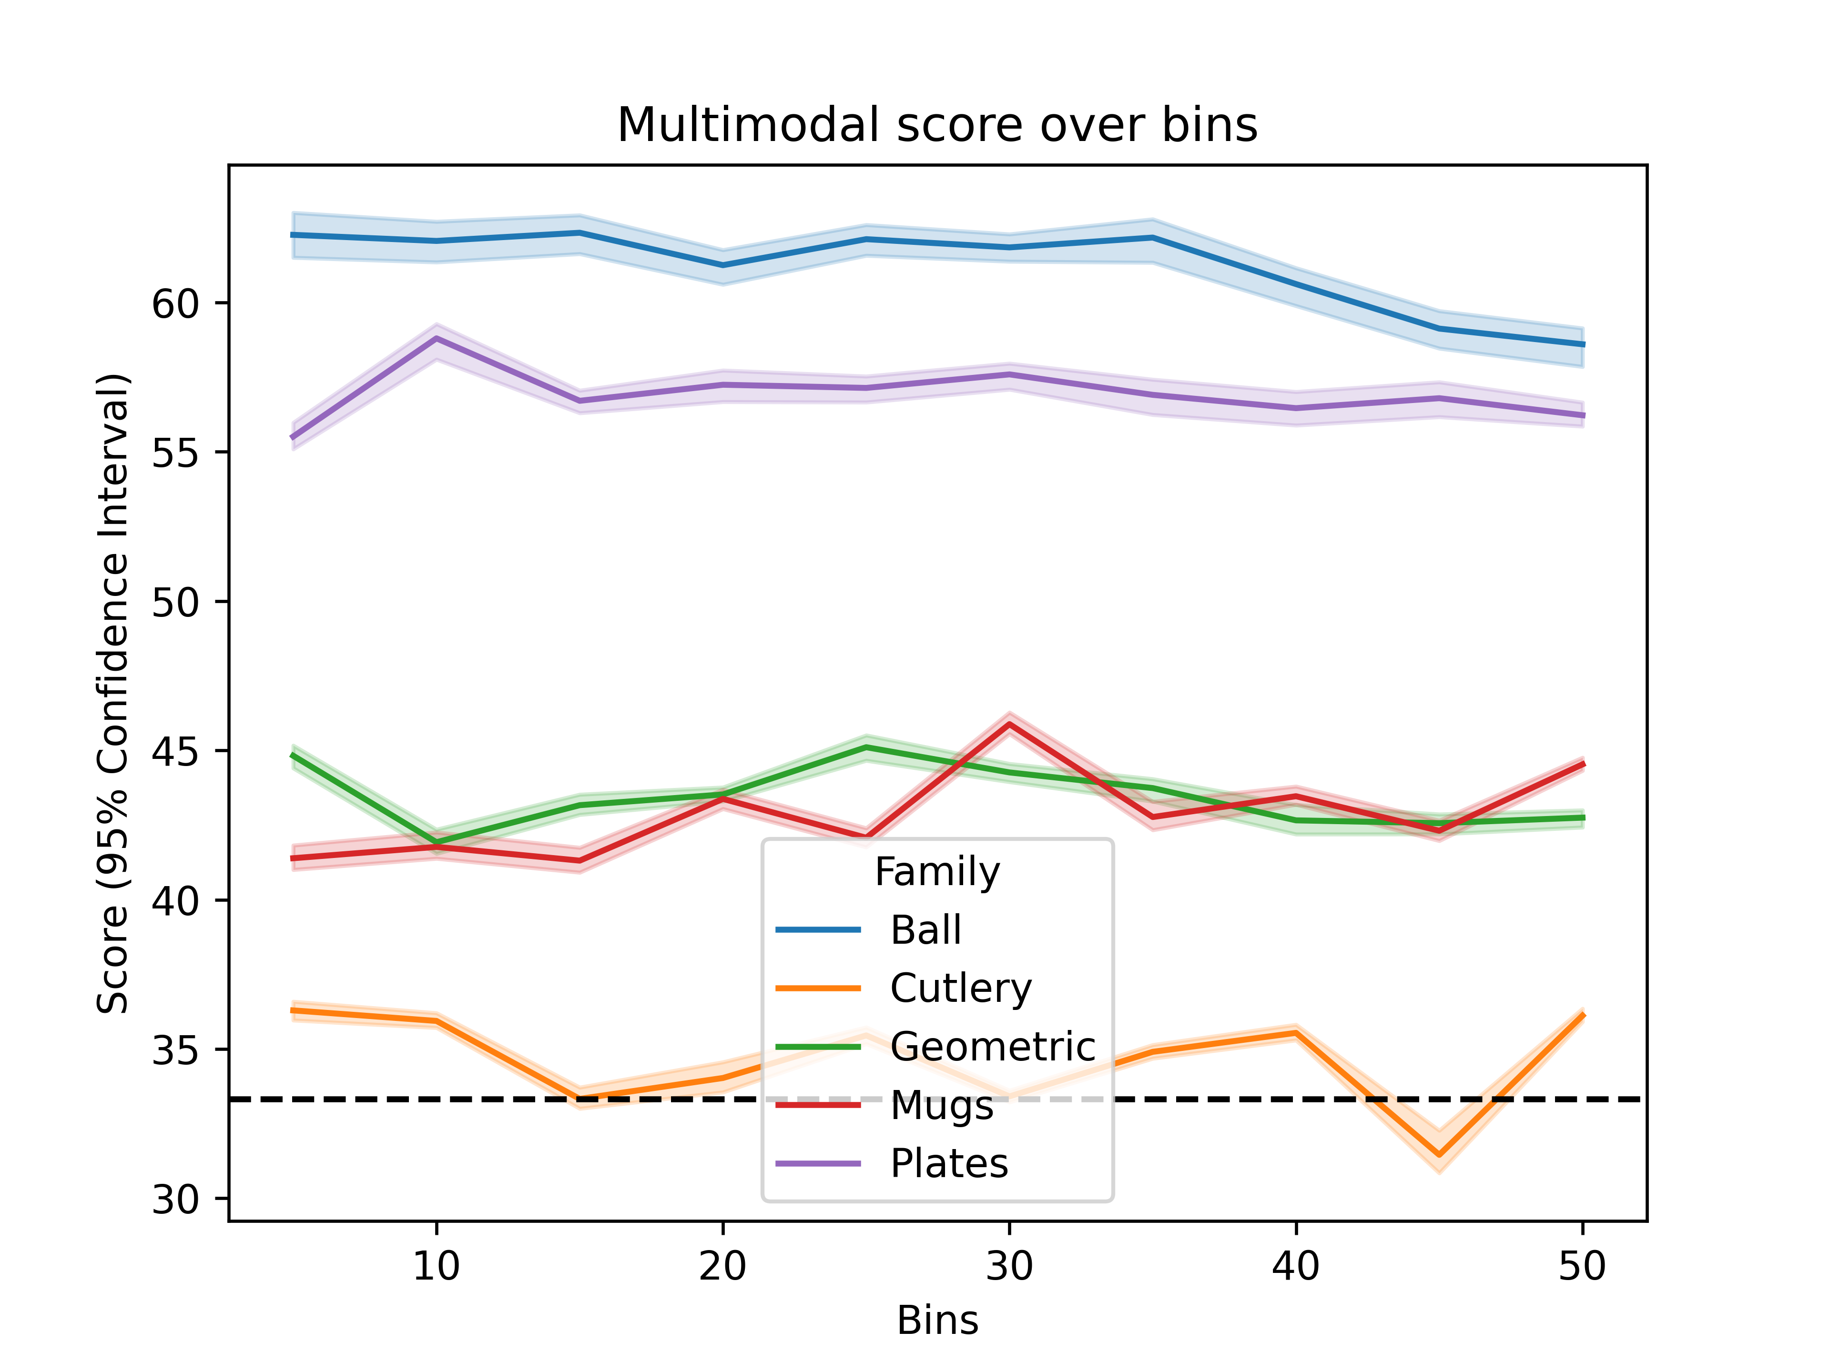

Slide 5
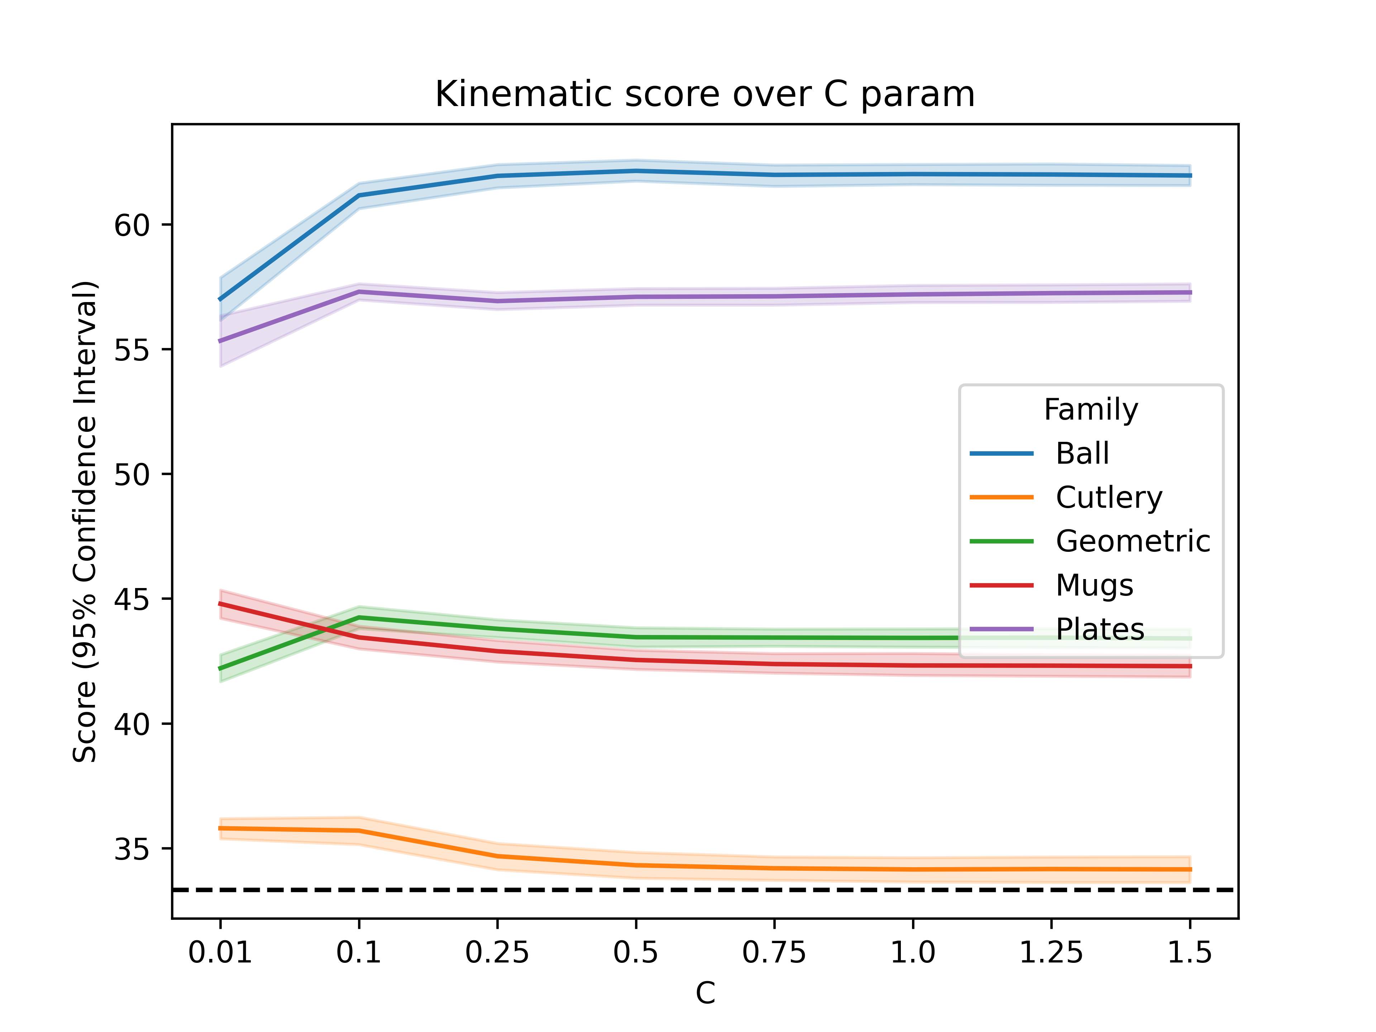
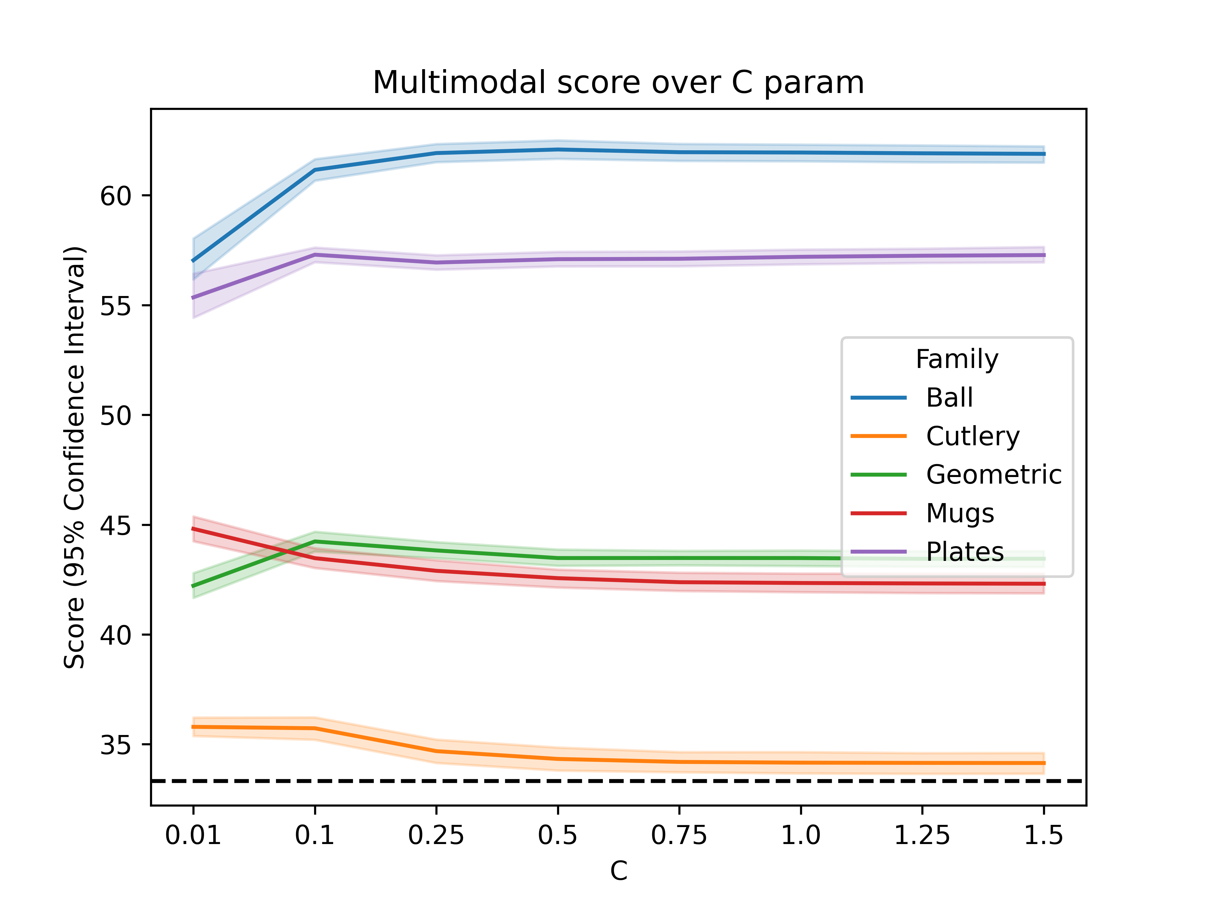

Slide 6
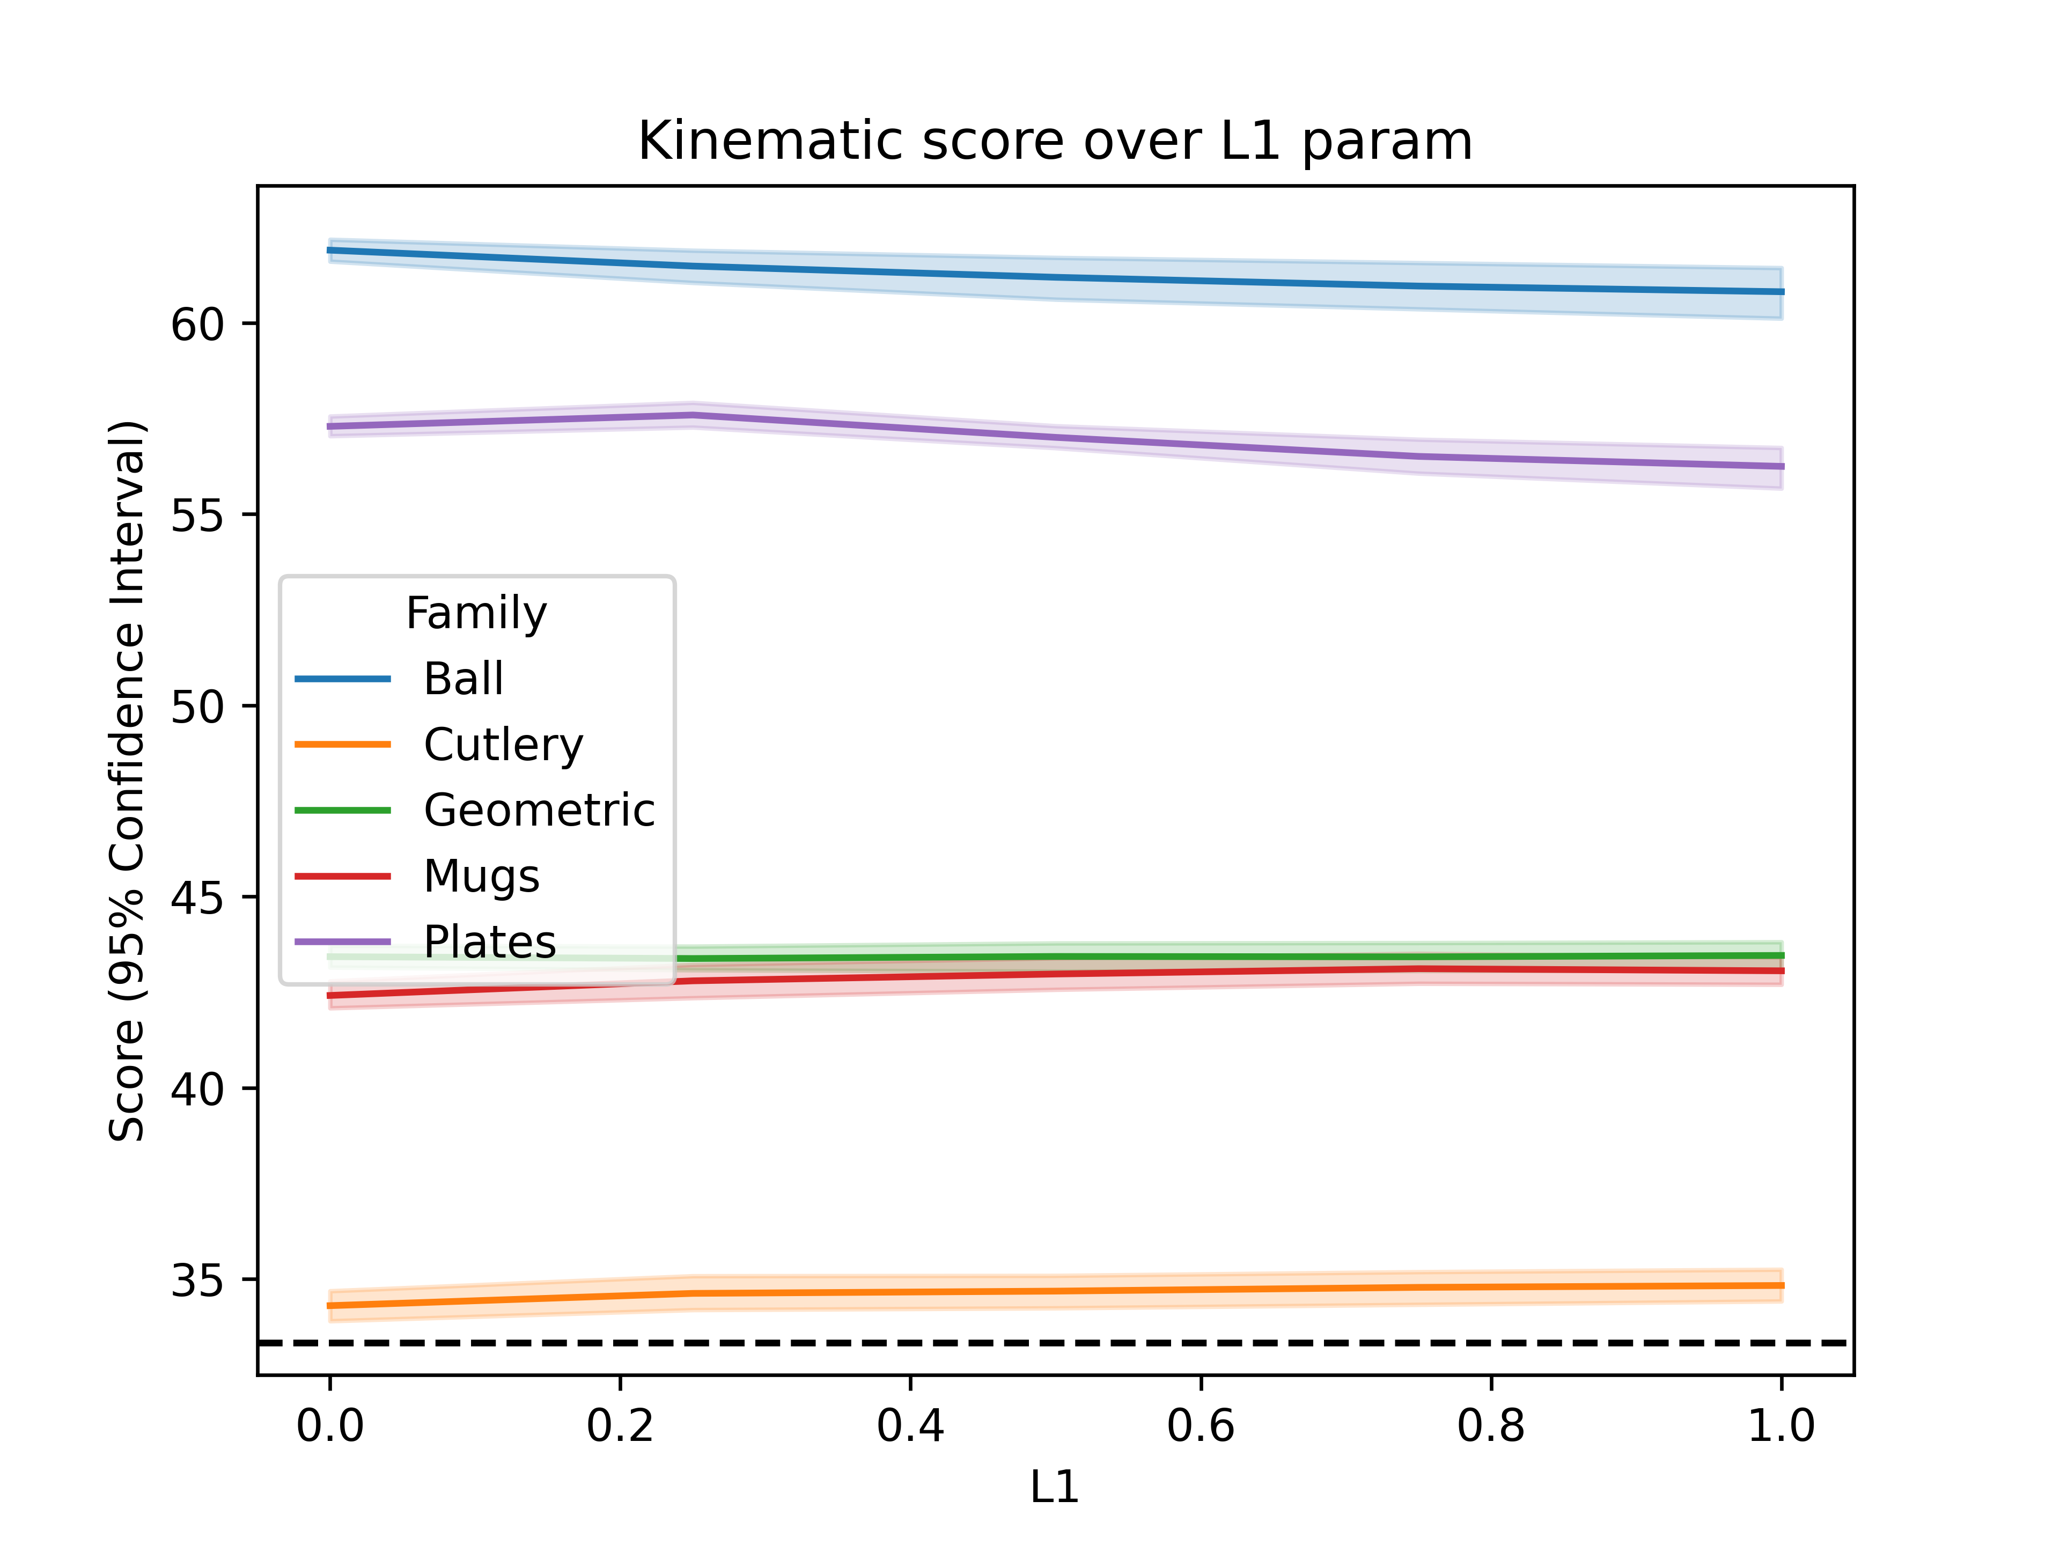
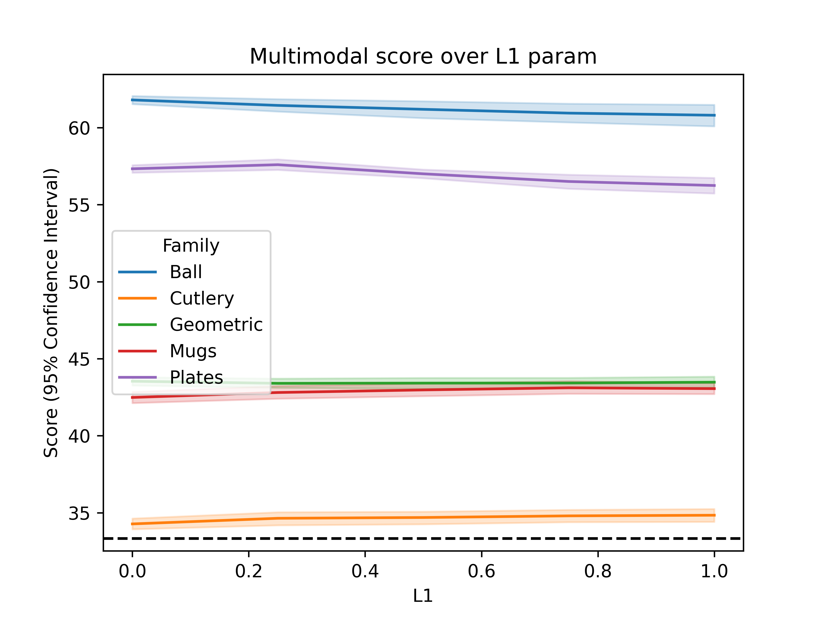

Slide 7
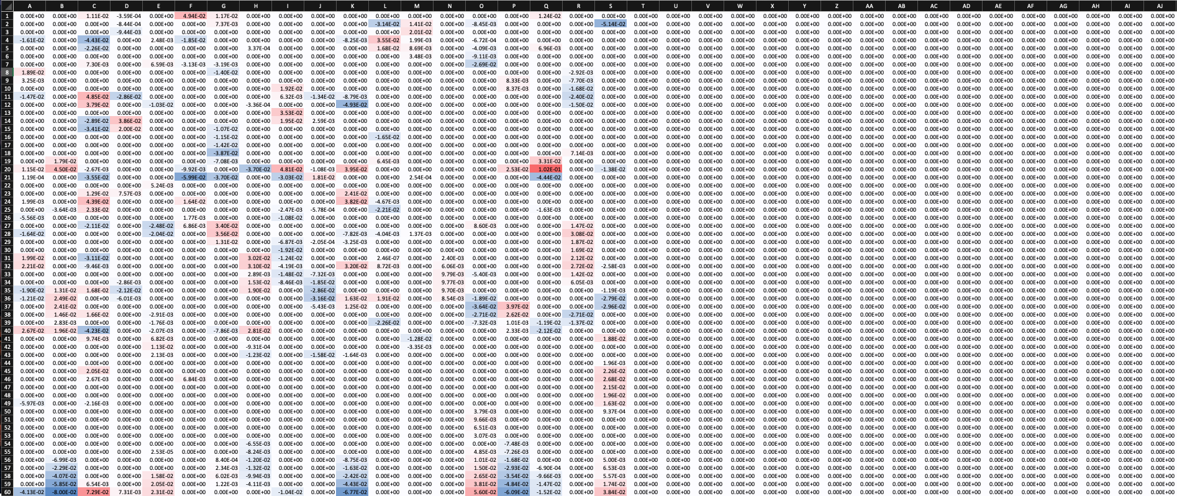

Slide 8
Output = [p_{a}, p_{b}, p_{c}]
2nd Layer Model
Input = [p_{a_kin}, p_{b_kin}, p_{c_kin}, p_{a_emg}, p_{b_emg}, p_{c_emg}]
Output = [p_{a}, p_{b}, p_{c}]
Output = [p_{a}, p_{b}, p_{c}]
Kinematic Model
EMG Model

Slide 9
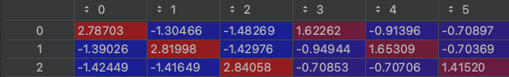
Output = [p_{a}, p_{b}, p_{c}]
2nd Layer Model
Input = [p_{a_kin}, p_{b_kin}, p_{c_kin}, p_{a_emg}, p_{b_emg}, p_{c_emg}]
Output = [p_{a}, p_{b}, p_{c}]
Output = [p_{a}, p_{b}, p_{c}]
Kinematic Model
EMG Model

Slide 10
Max accuracy for EMG: 42.75 % with 40 Bins, L1 = 0 and C = 1.25
Max accuracy for Kinematic: 50.05 % with 20 Bins, L1 = 1 and C = 0.1
Max accuracy for Multimodal: 50.05 % with 20 Bins, L1 = 1 and C = 0.1
Max accuracy for Hierachical: 51.76 % with C = 0.75

